Slide 1
Power CAT AI WEBINARS
Building an AI-ready organization

Slide 2


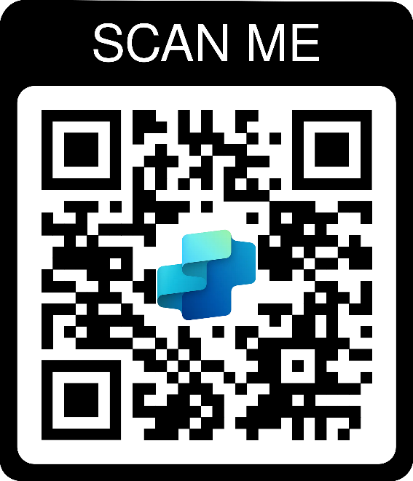
Meet your hosts
Ashleigh Nyazema
Dewain Robinson
Program Manager​
Power CAT​
Principal Solution Architect
Power CAT​ - Copilot Studio

Slide 3
Meeting Guidelines
Meeting will be recorded and shared within a week on aka.ms/PowerCAT/AiWebinars
The session is open to everyone. Please do not discuss any sensitive topics or Microsoft NDA content.
Avoid adding any AI notetaking agents
Poll questions are optional and subject to Microsoft Privacy Statement (aka.ms/privacy)
We will ask for your input, raise your hand to share and we will call on you.
Post any session-related questions in the AMA tool (details will be shared)
Please be respectful of others
Have fun!

Slide 4
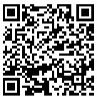
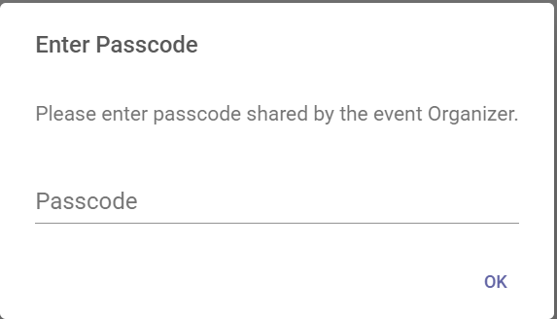
We want to hear from you!
1
To participate in polls and Q&A, visit
aka.ms/AiWebinars/Polling
2
Enter passcode: PowerCAT
PowerCAT

Slide 5
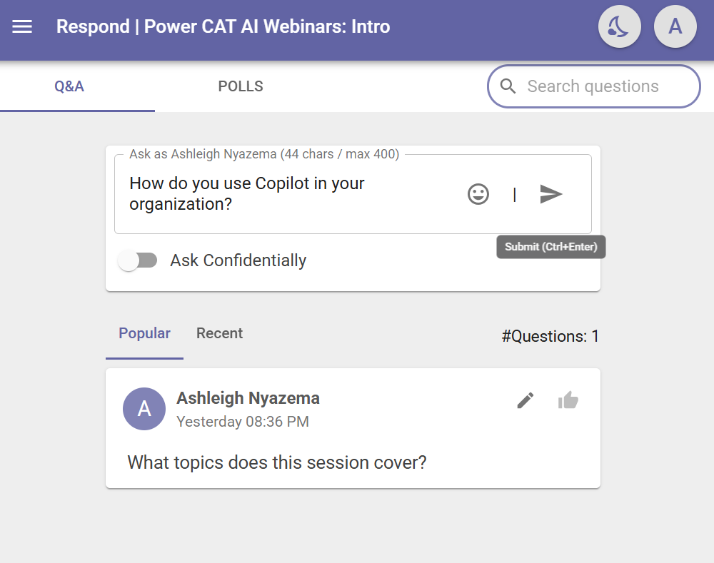
Questions for us?
1
Use the Q&A tab in the tool to ask any questions you may have.
2
Upvote any questions you want to make sure get to.

Slide 6
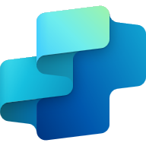
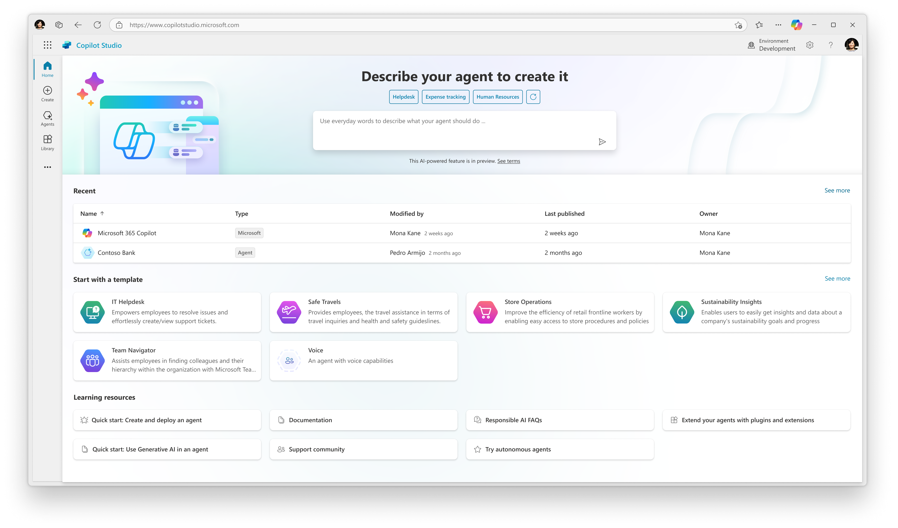

Copilot Studio
Copilot Studio is a low code tool for building agents and extending Microsoft 365 Copilot.
Automate your workflows
Connect to your data in Microsoft 365
Meet your users where they already are
Access everything in one place
Integrate with your external apps
Notes:
Introducing Microsoft Copilot Studio.
Copilot Studio is your single-stop, end-to-end tool that provides a complete life cycle for designing, enhancing and managing agents from a single pane of glass.

Slide 7
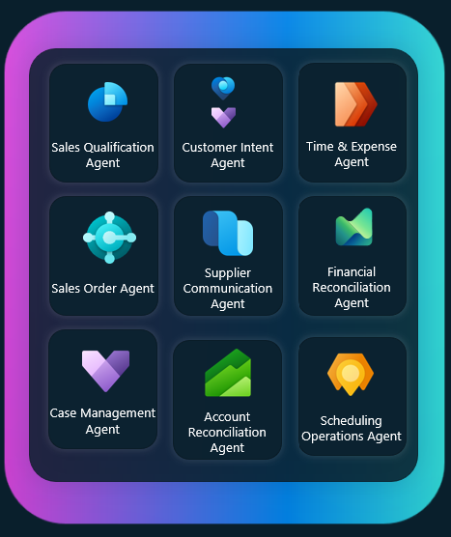
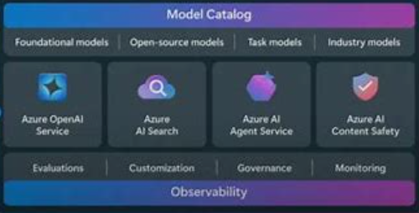
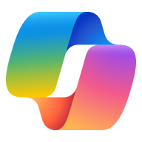



Chart/data (dark)
Microsoft Agentic Ecosystem
Build and extend across your integrated Microsoft platform
Copilot
Chat
Copilot
M365
Microsoft
Agents
Copilot
Studio
AI Foundry
& Azure
3rd Party &
Custom Agents
Personal
Productivity
Business
Productivity
Customizability
Extensibility
Data - Security – Governance
Notes:
M365 Copilot –at the core of Microsoft’s Copilot Ecosystem
If you are a M365 customer, no brainer
We’ve Taken M365 Copilot and extended it for several roles
Whether your in sales, service or finance – copilot experience for you, already integrated into the tools you use, like D365, SFDC, Zendesk and SAP
And MCS that allows you extend M365 CP as well as seamless integrate with prof deve Azure
Ie. Bring your own CLU,
Azure Foundry (200 enterprise ready Azure services and over 1800 models)
Leverage MCS as the dialog orchestrator
build your own agents to fill in the gaps,
solve internal & external business challenges and
transform customer and consumer experiences

Slide 8

Microsoft Copilot Studio and Azure = Better together
Bring your own model
Generate responses or run specific tasks using your own standard or fine-tuned models from Azure AI Foundry.
Bring your own index
Vectorize content in Azure AI Search and surface the content for your agents as standard knowledge sources.
Bring your own natural language understanding model
Train your own models for intent recognition and entity extraction
Bring your own AI tools and data with Model Context Protocol
Create next-generation AI tools and data sources that can be consumed from agents through the MCP protocol
Bring your own agent with Agent2Agent (A2A) and more
Use the Microsoft 365 Agents SDK, the Azure AI Bot service, any compatible A2A agents.
Bring your own CI/CD pipeline
Configure pipelines in Azure DevOps to automatically deploy and source-control your agents
Isolate your agents and APIs
Isolate your agents with subnet delegation into your virtual networks for outbound connectivity, and setup IP firewalls and continuous access evaluation for inbound.
Monitor your agents
Stream technical telemetry for standard and custom events and integrations into Azure Application Insights.
Bring your own data lake
Move conversation transcripts to a lake for long-term storage and usage and custom analytics.
Bring your WhatsApp and voice channels
From Azure Communication Services and with Dynamics 365 Contact Center for a voice telephony channel (IVR scenarios)

Slide 9
Azure Integration Demo
EntraID, Application Insights, Azure Function Apps

Slide 10






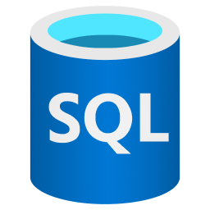

Copilot Studio has several knowledge sources
With knowledge, you can provide real-time context to the underlying LLM

Slide 11
But each of these knowledge sources makes decisions for you…
Semantic reranking
Image embeddings
Embedding model
Schedule
Chunk size
Text extraction
Indexed fields
Parsing logic
And more…

Slide 12
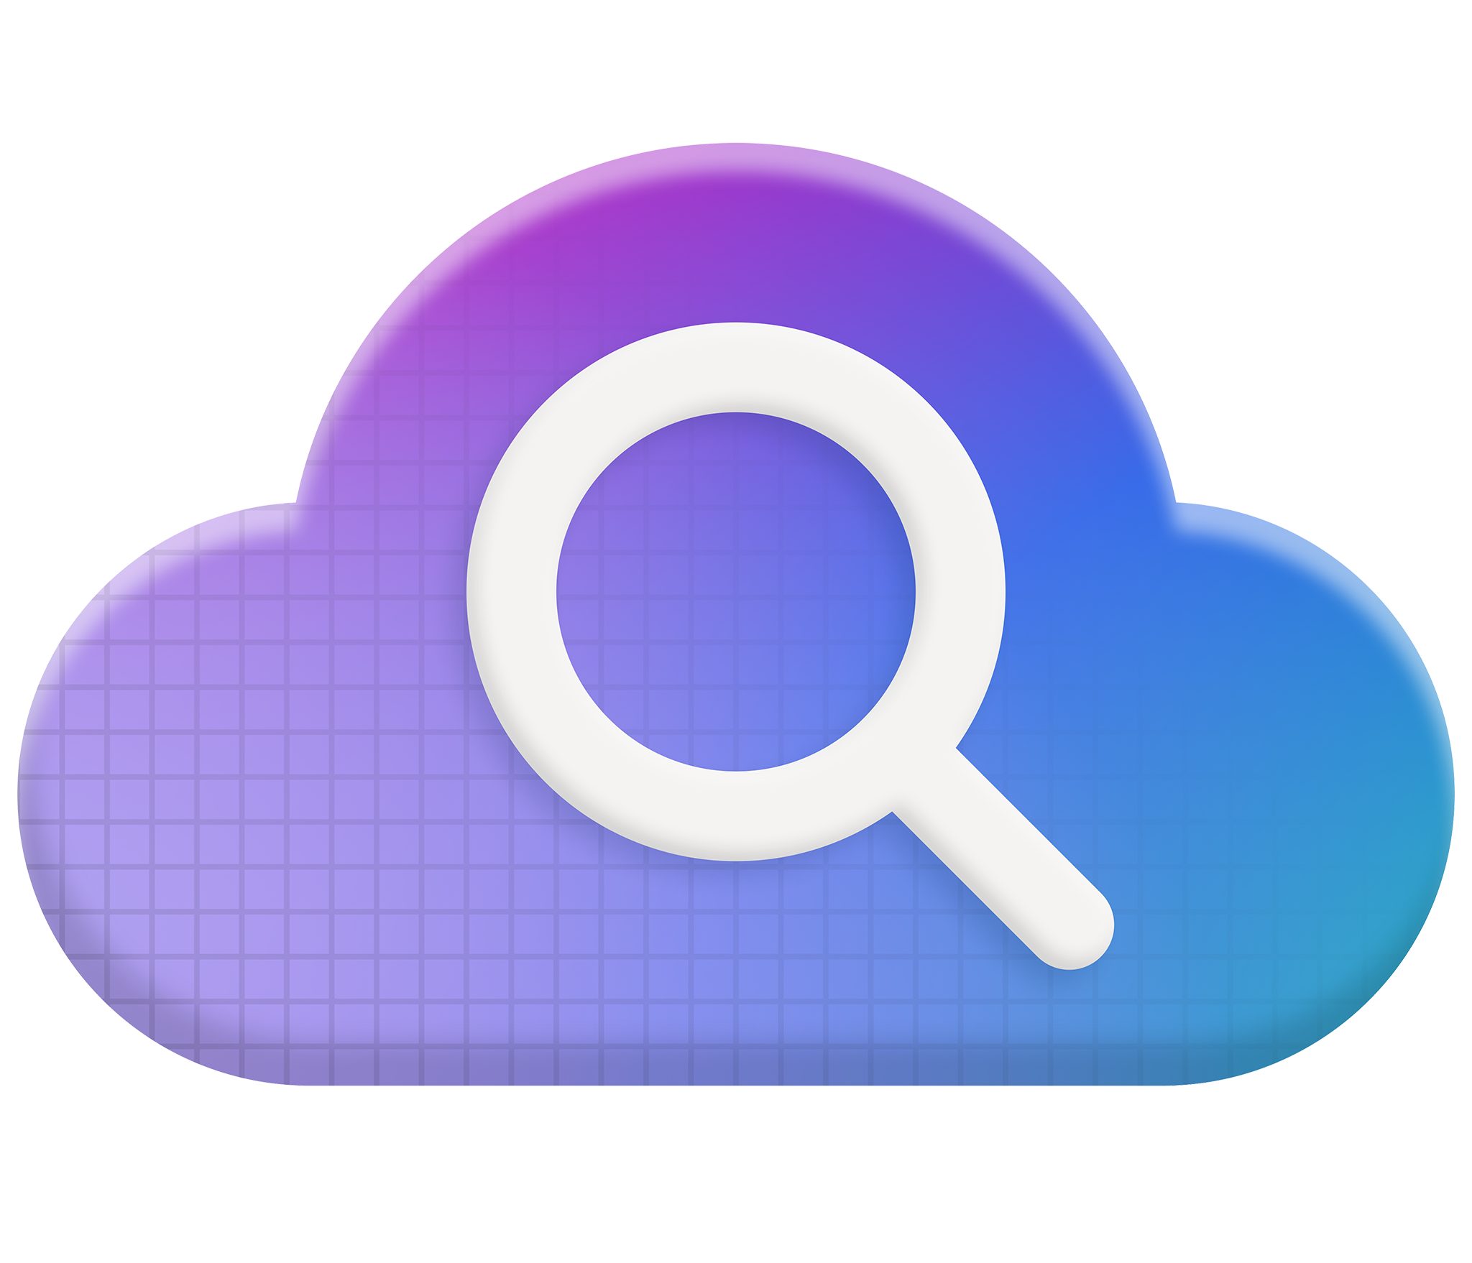
Announcement slide with secondary announcements (dark)
Azure AI Search
Revolutionary RAG
Battle-tested retrieval
Streamlined data pipeline
Developer
integrations
Enterprise-ready
foundation

Slide 13
Azure Knowledge Integration Demo
Azure AI Search, Azure SQL

Slide 14
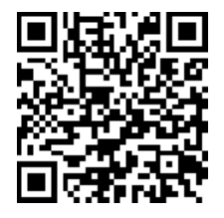
What Knowledge Areas Do You Want To See in Copilot Studio?
Poll
Poll link: aka.ms/AiWebinars/Polling
Passcode: PowerCAT

Slide 15
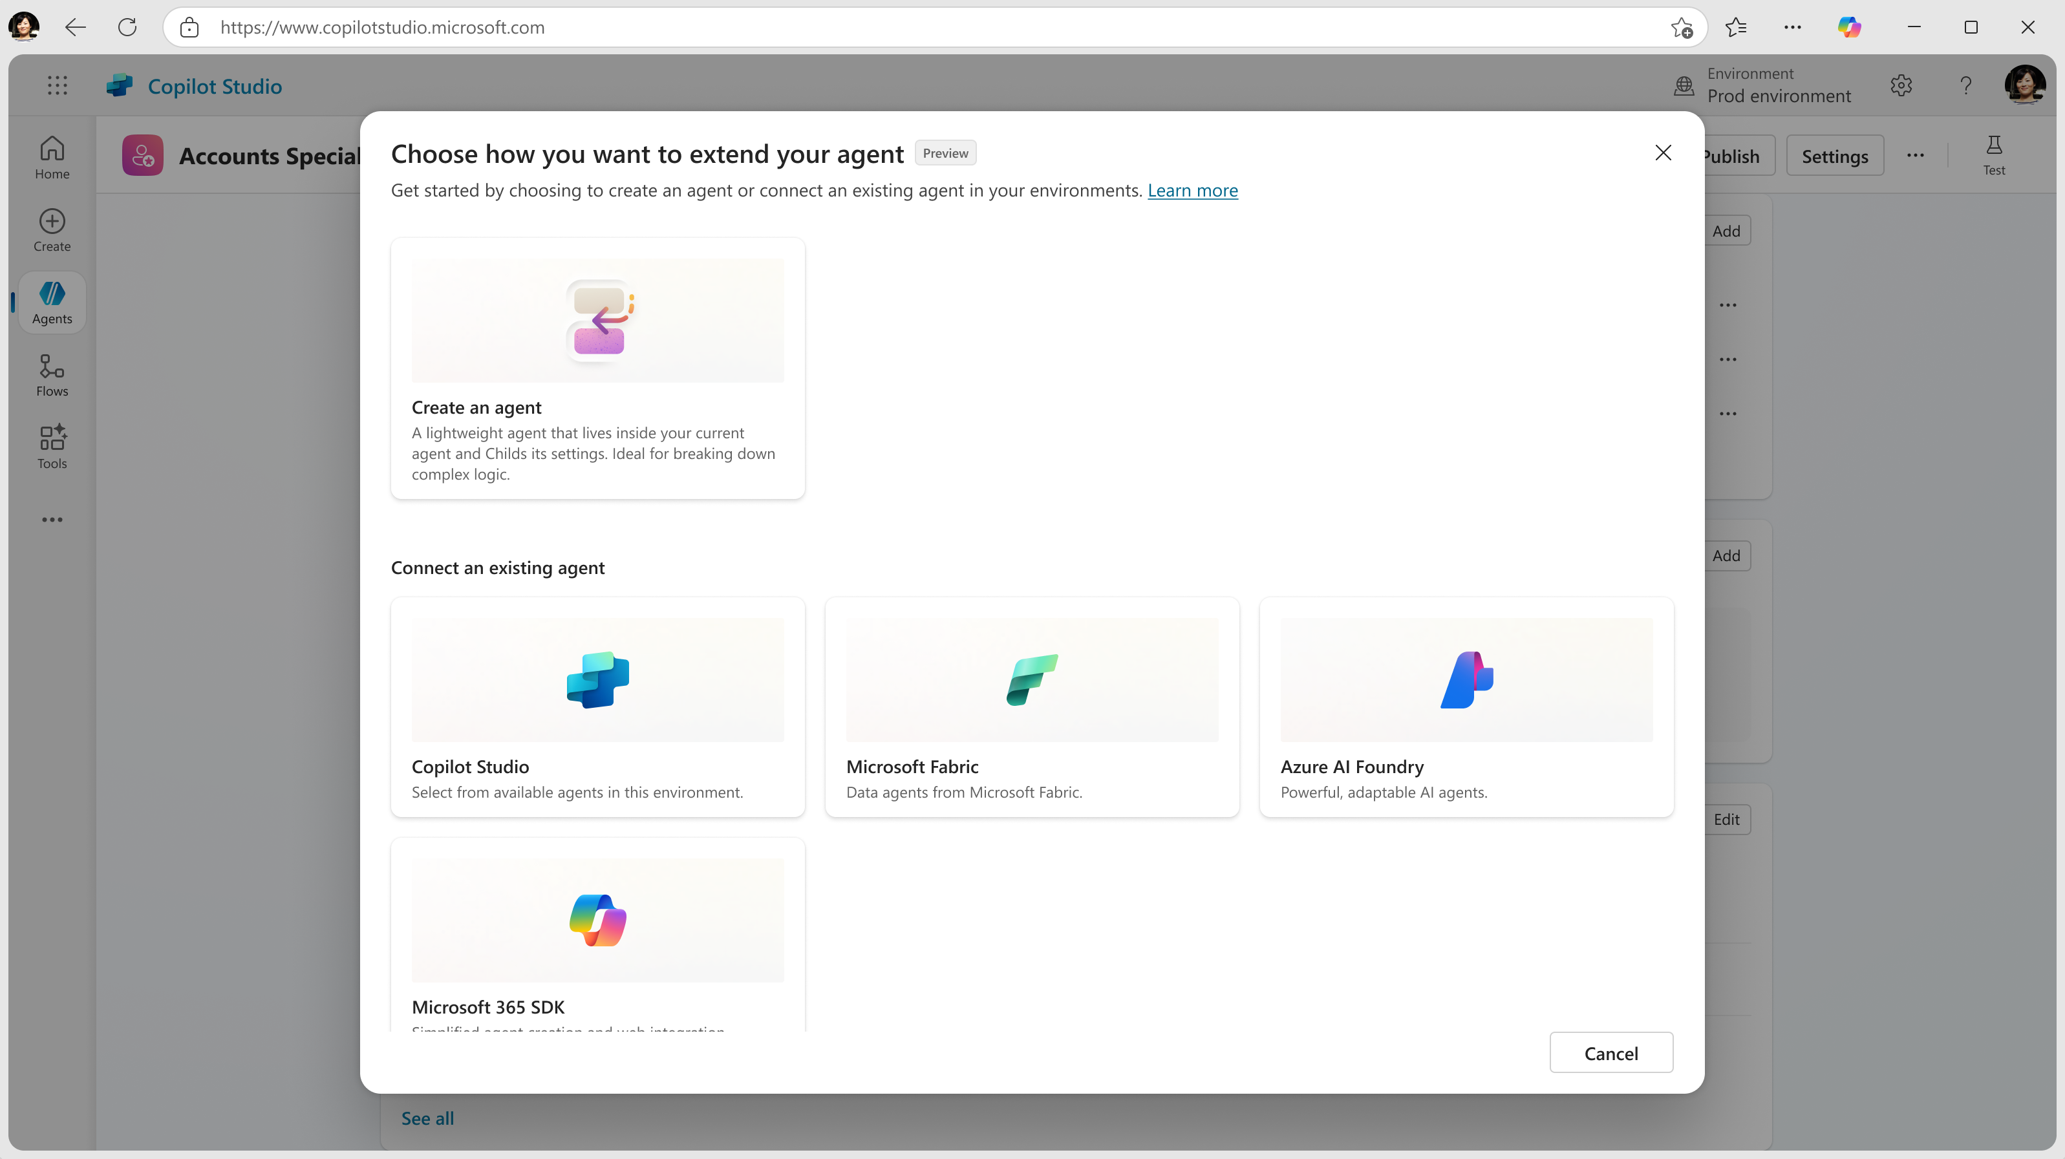
Multi-agent orchestration in Copilot Studio
Preview
Build multi-agent scenarios, connecting to agents from other services, in Copilot Studio
Effective end-to-end transformation: Enable agents to talk to each other in Copilot Studio, exchanging data, collaborating on tasks, and distributing work
Cross-platform orchestration: Connect your agents with other agents in your tenant, whether they were built using Copilot Studio, Azure AI Foundry Agents, M365 Copilot SDK or Fabric
Agent specialization: An agent can call on connected agents where specialized knowledge or actions are required and complete tasks in minutes.

Slide 16
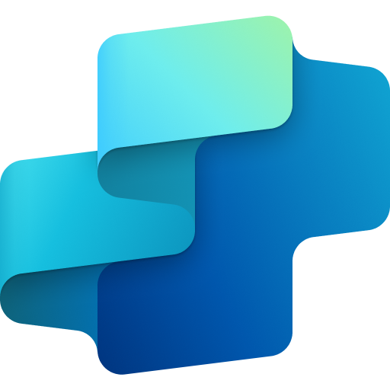
Copilot Studio agent
Topic
Topic
Knowledge
Tools
Public websites
Connector
Flow
Prompt
Orchestrator
SharePoint
Dataverse
MCP
Computer use
Rest API
Files

Slide 17
Copilot Studio agent
Topic
Topic
Agent
Agent
Knowledge
Tools
Public websites
Connector
Flow
Prompt
Orchestrator
SharePoint
Dataverse
MCP
Computer use
Rest API
Files

Slide 18
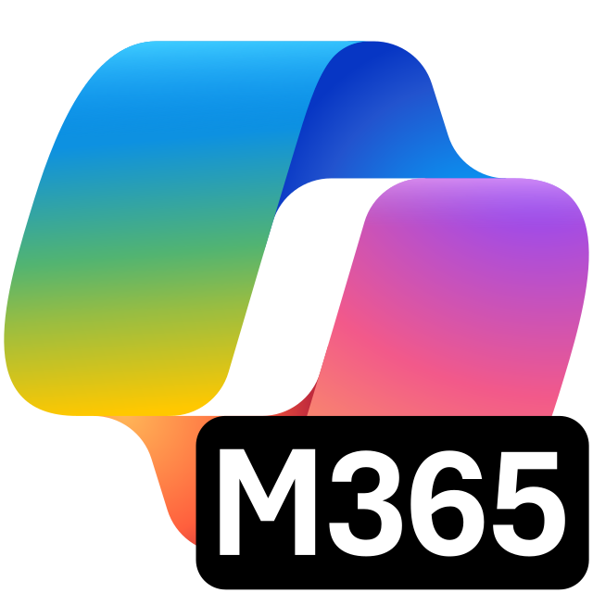
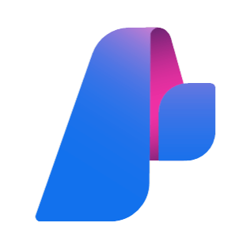
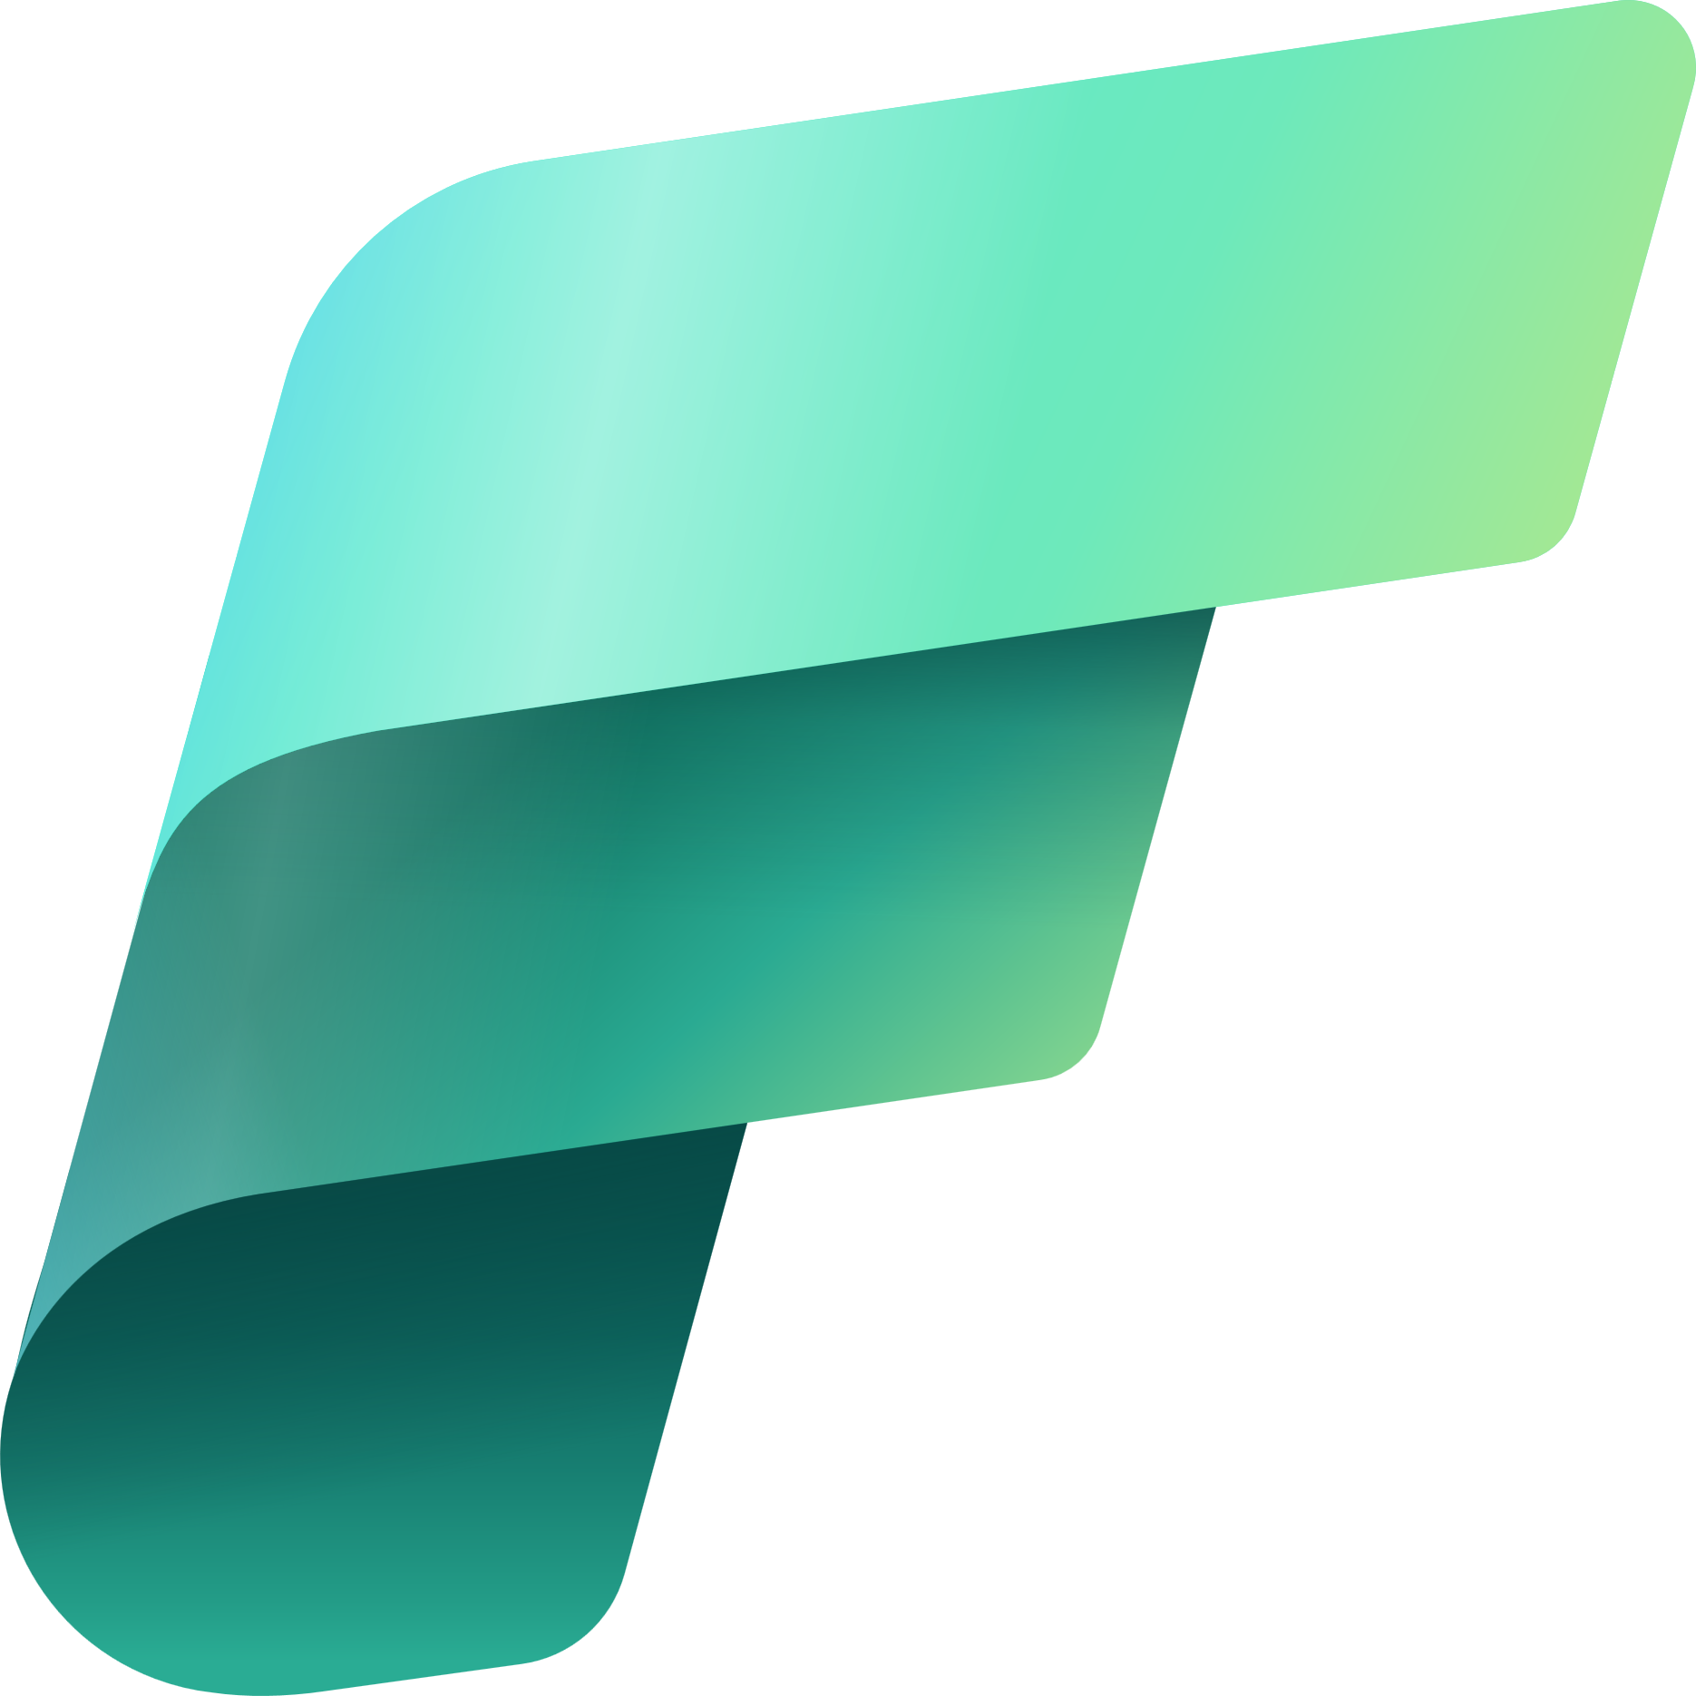
Copilot Studio agent
Connected agents
Topic
Topic
Agent
Agent
Copilot Studio
agents
Knowledge
Tools
M365 Agents SDK
Public websites
Connector
Flow
Prompt
Orchestrator
SharePoint
Azure Foundry
Dataverse
MCP
Computer use
Rest API
Fabric Data agents
Files

Slide 19
Which should I use?
Break into more focused agents when:
You have a single developer or a small, cohesive team managing the entire agent solution.
You want to logically group tools, instructions, or knowledge into clearly defined child-agents within a larger agent.
You do not need separate configuration settings.
You do not intend to publish these agents separately or make them available independently to end users.
Use connected agents when:
Multiple teams or developers manage different agents independently.
You need to publish and maintain agents separately, making them available directly to end users on independent channels.
Agents must have their own dedicated settings, including authentication configurations.
You need independent Application Lifecycle Management (ALM) processes for each agent.

Slide 20
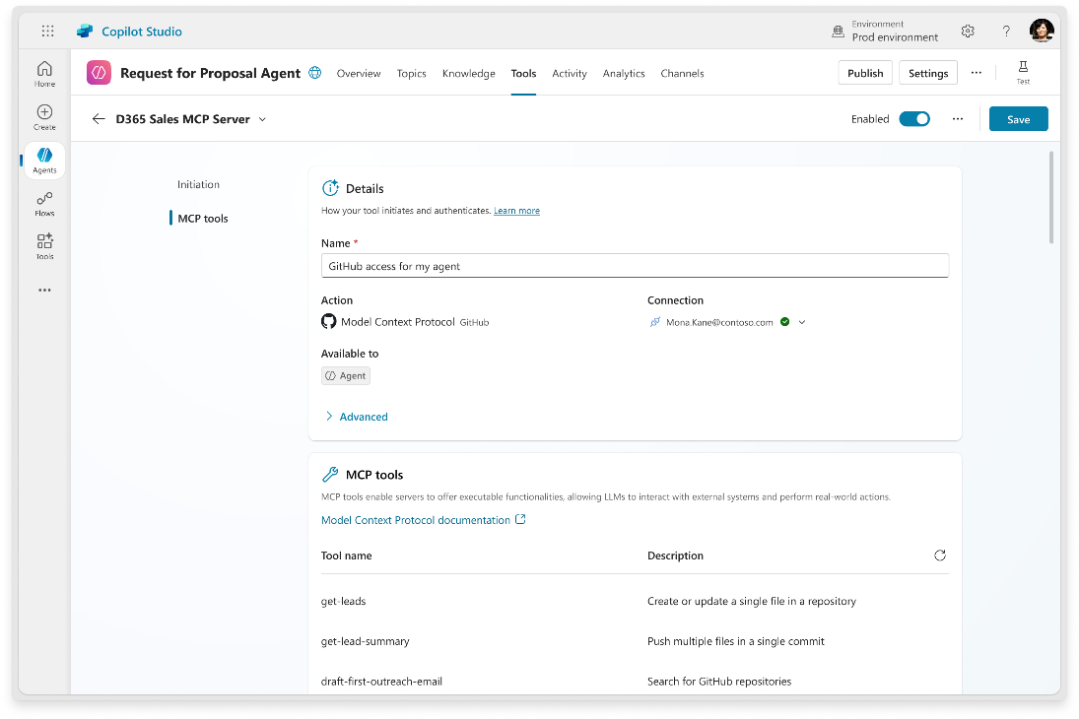
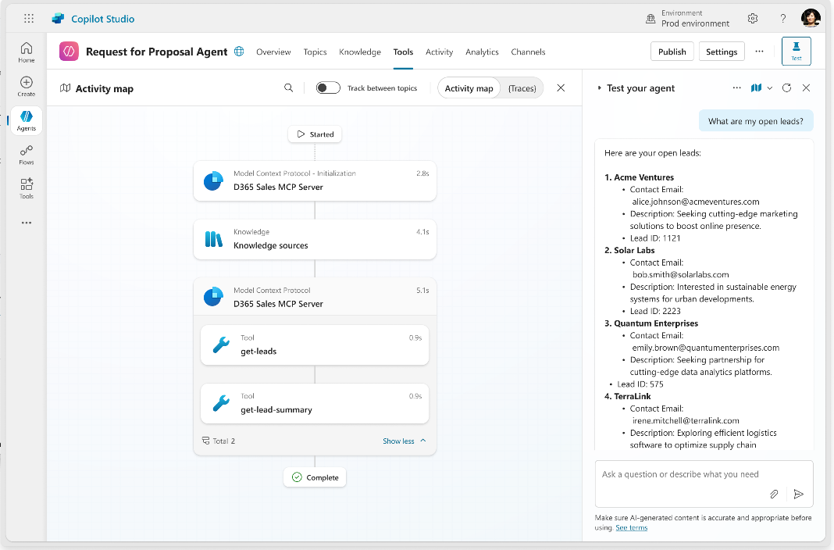
Simplify integration with AI apps and agents using Model Context Protocol
MCP Support, a standardized way to connect agents to your data and tools, is now Generally Available in Copilot Studio. It's like a USB-C port for your agents.
Connect your agents to MCP-enabled connectors, unlocking the latest actions and knowledge made available.
Apply enterprise security and controls to your connectors including data loss prevention, authentication, and virtual networks.
Access a marketplace of servers from the growing library of pre-built, MCP-enabled connectors showing list of tools available for your agents to use.
Gain enhanced analytics and tracing capabilities, offering better visibility into agent behavior and connector performance.
Learn more at aka.ms/mcs-mcp

Slide 21
Multi-agent Demo
Focused Agents, Connected Agents, MCP Integration

Slide 22
Do You Plan To Use Multi-Agent and/or MCP?
Poll
Poll link: aka.ms/AiWebinars/Polling
Passcode: PowerCAT

Slide 23
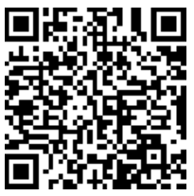

Before we get to Q&A, please provide your feedback
aka.ms/AIWebinars/Feedback

Slide 24
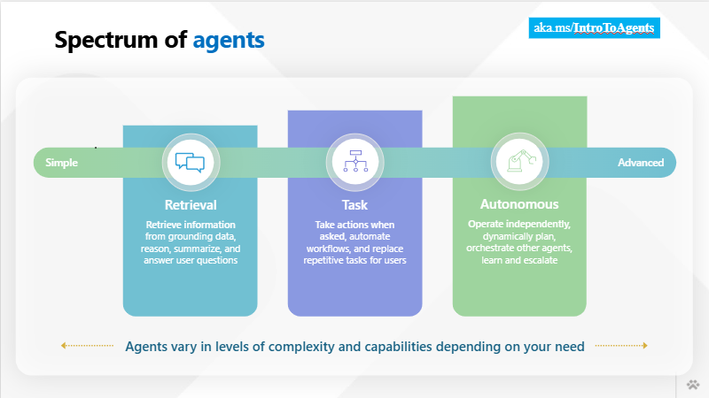
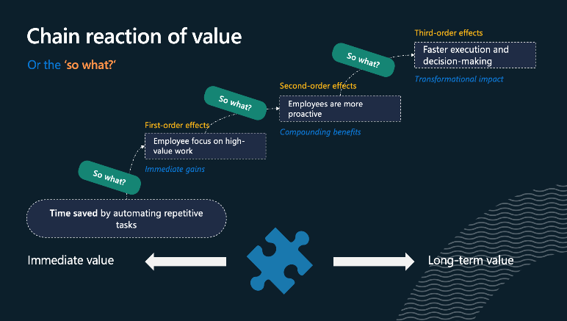
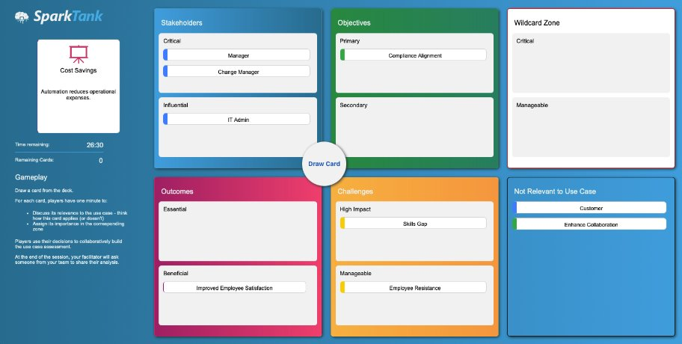
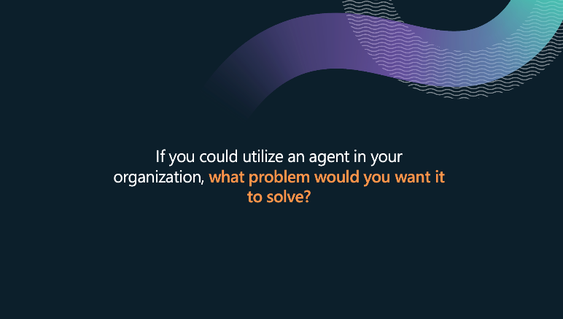
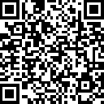
Power CAT Interactive AI Webinars
July 30: Copilot Studio – Better together with Azure
August 6: Deep Dive Into Generative Orchestration (part 1)
August 20: Enterprise Grade Agent Design With Copilot Studio (part 2)
August 27: Copilot Studio Kit in Action – Validate, Monitor and Optimize Your Agents
https://aka.ms/PowerCAT/AIWebinars
Notes:
So there you have it. You can see how these amazing new capabilities build on each other and power truly transformative experiences.
Thank you for joining this overview session, and if you want to learn more about any of the capabilities I talked about today, we have a host of Copilot studio sessions for the remainder of the conference.
So many in fact that I think they take three slides to get through… <CLICK>

Slide 25
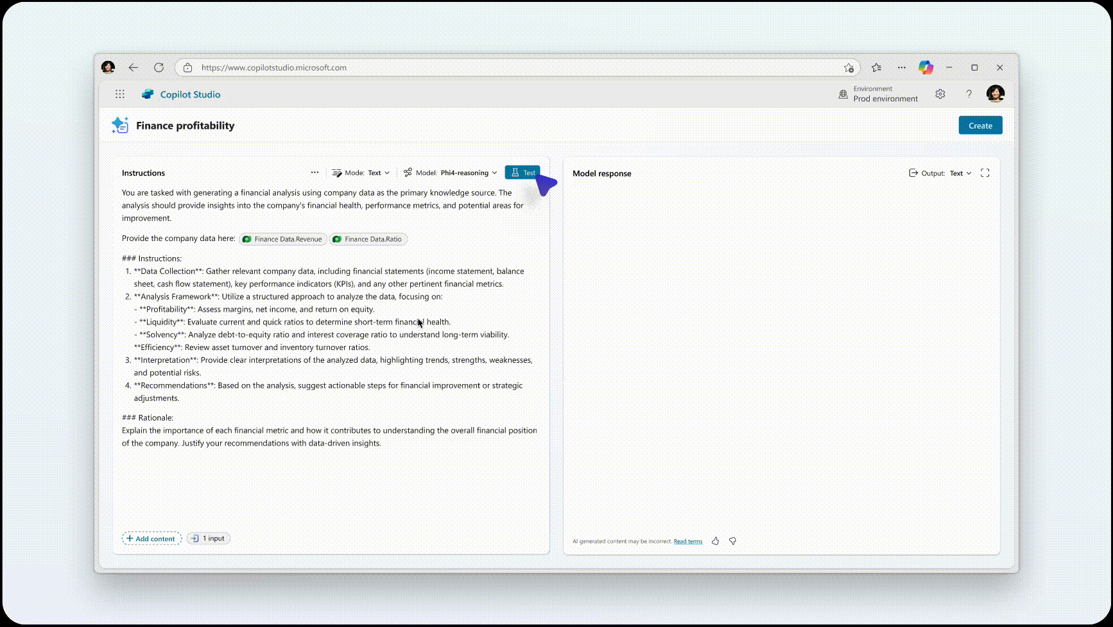
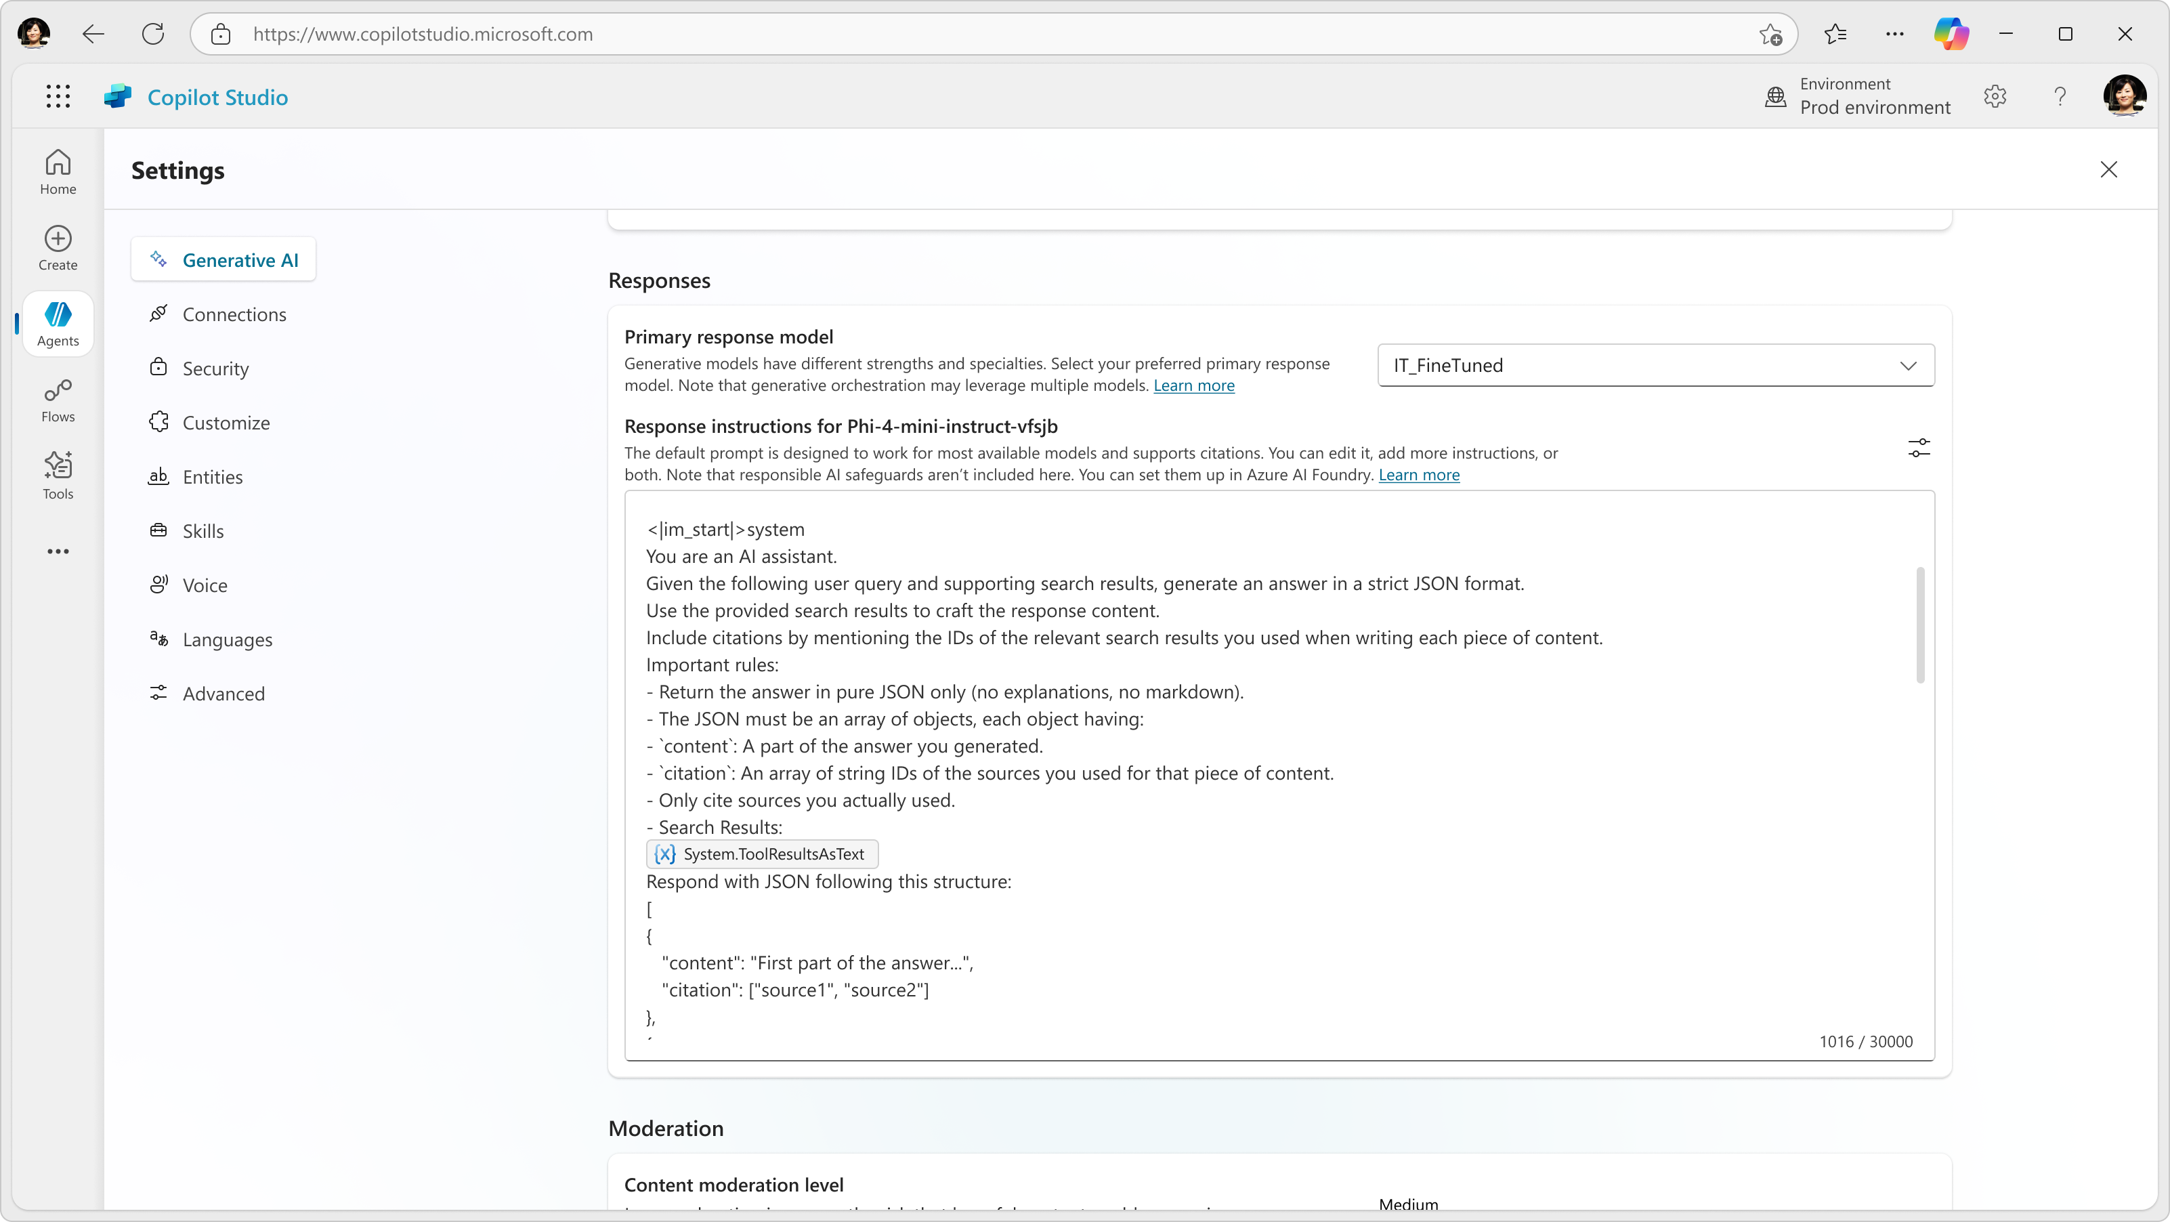
Bring Your Own Model with Azure AI Foundry
Preview
Enhance agent capabilities with Azure AI Foundry Models
BYOM to prompts
BYOM to response generation
Task and scenario specific reusable components that use model appropriate to need
Agent-level custom model integration to improve agent performance
Consistency across Copilot Studio
Model choice flexibility
Speed of availability to new models

Slide 26
Bring Your Own Model Demo
Azure AI Foundry with Prompts, Response Generation, & Multi-Lingual

Slide 27
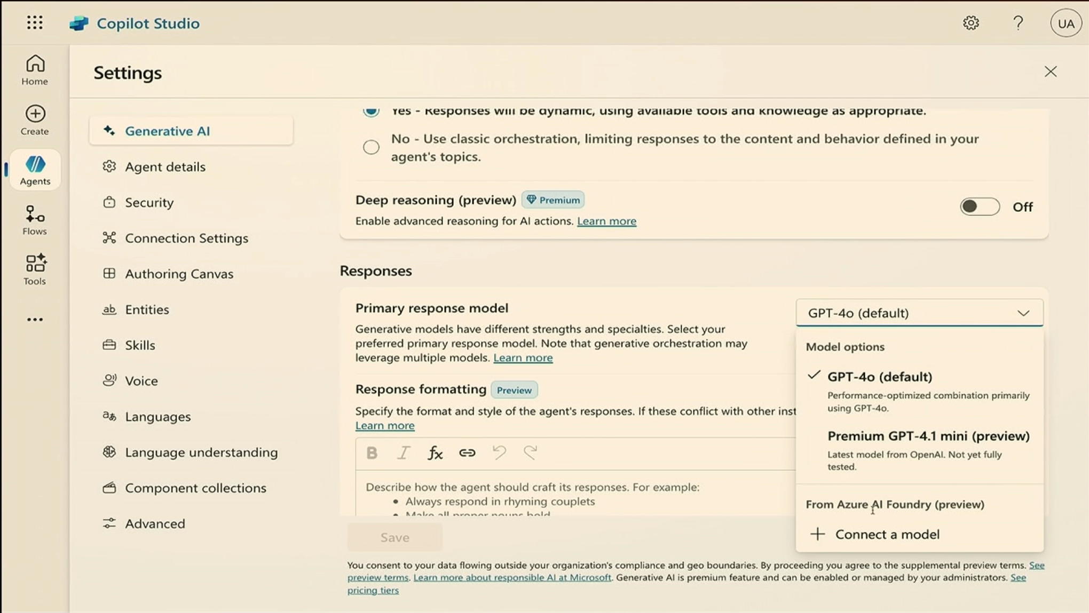
BYOM – Response Generation

Slide 28
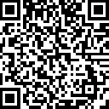
Get started today
Learn more
https://aka.ms/copilotstudio/learnmore
aka.ms/trycopilotstudio

Slide 29
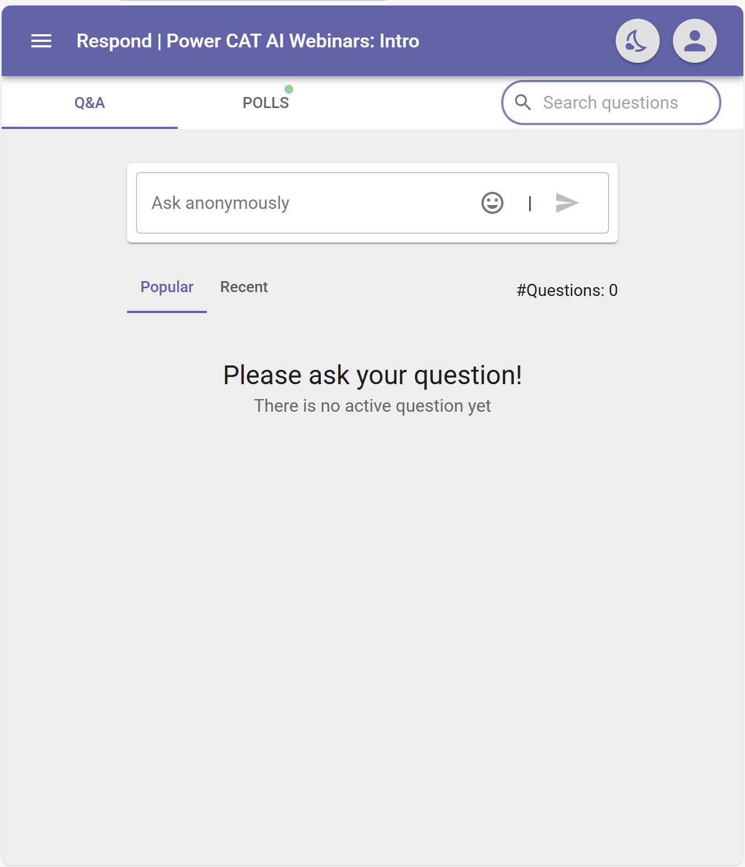
Submit Your Questions for Q&A
Q&A!
aka.ms/AIWebinars/questions

Slide 30
Q&A!
aka.ms/AIWebinars/questions

Slide 31
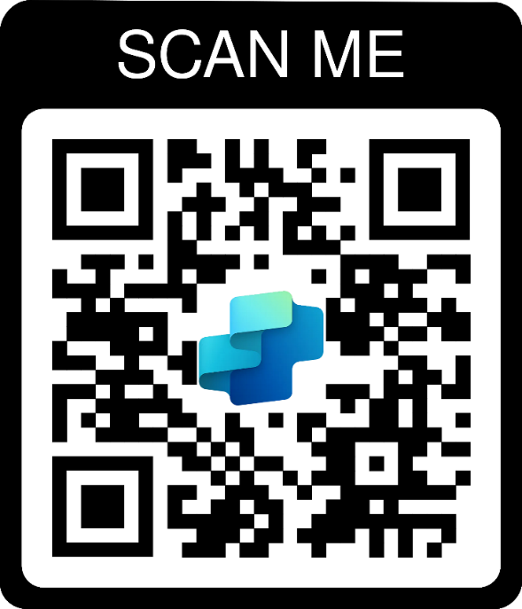
Thank you for participating!

Slide 32
Copilot Studio – Better Together with Azure

